Slide 1
Security Aspects of Container Orchestration
Patrick Deutschmann, 28 June 2019

Slide 2
Image Source: docker.com, accessed 20 June 2019

Slide 3
Image Source: docker.com, accessed 20 June 2019

Slide 4
Distributed?
Scaling?
Communication?
Deployment?
Health?
Image Source: docker.com, accessed 20 June 2019

Slide 5
Image Source: kubernetes.io, accessed 20 June 2019

Slide 6
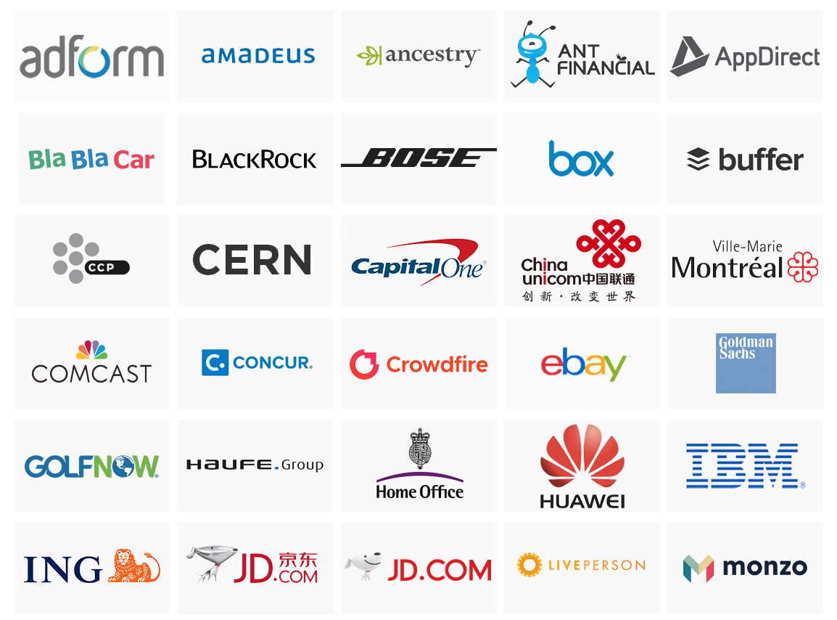
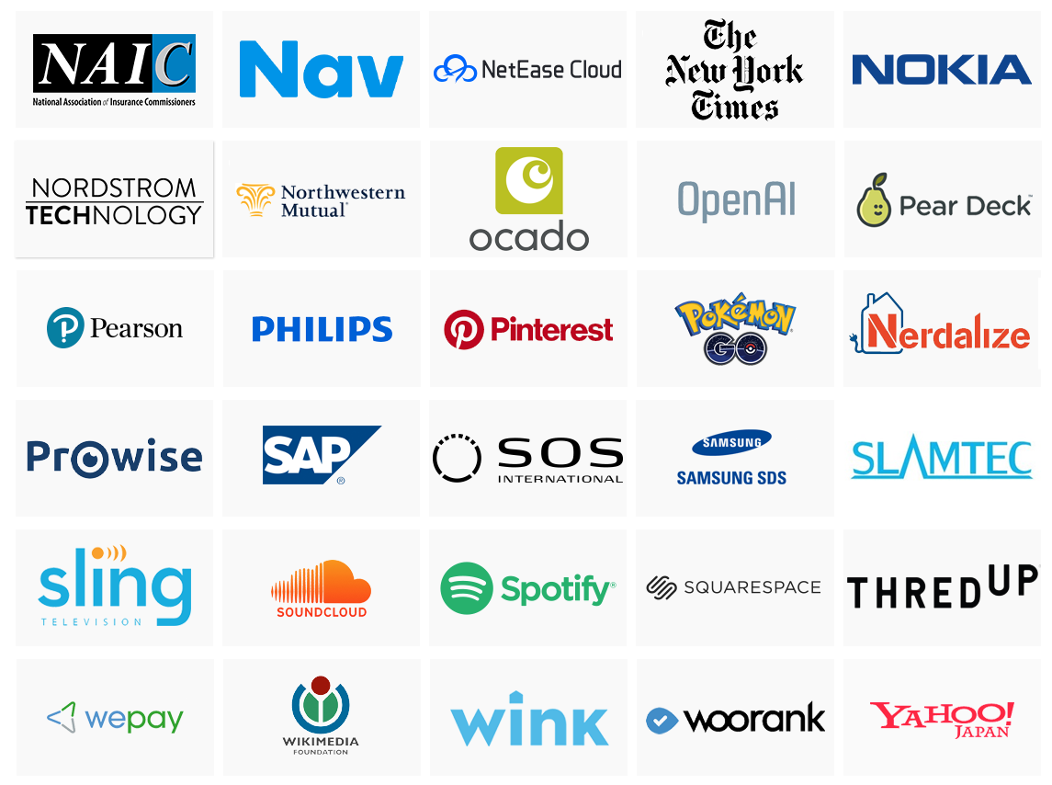
Image Source: kubernetes.io, accessed 20 June 2019

Slide 7
Configuration Management
Service Discovery
Load Balancing
Storage Orchestration
Healing
Scaling
Auto Rollout
Image Source: kubernetes.io, accessed 20 June 2019

Slide 8
Image Source: https://blog.risingstack.com/what-is-kubernetes-how-to-get-started/, accessed 20 June 2019

Slide 9
Image Source: https://mapr.com/blog/kubernetes-kafka-event-sourcing-architecture-patterns-and-use-case-examples/, accessed 20 June 2019

Slide 10
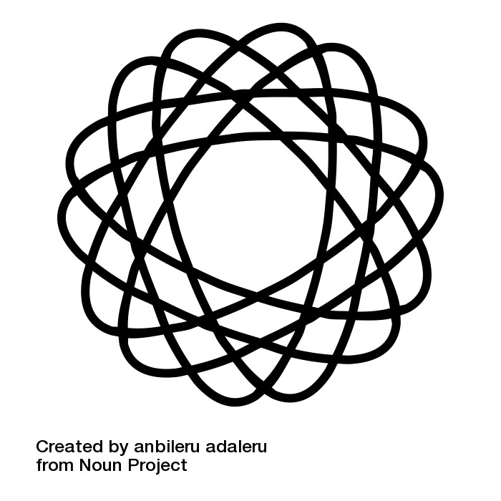
Complexity

Slide 11
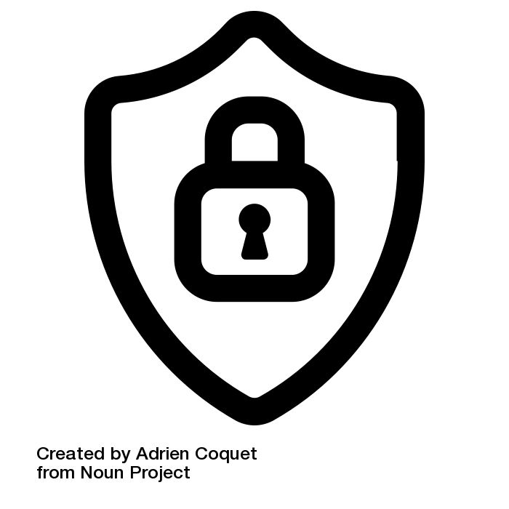
Complexity
→
Security?

Slide 12
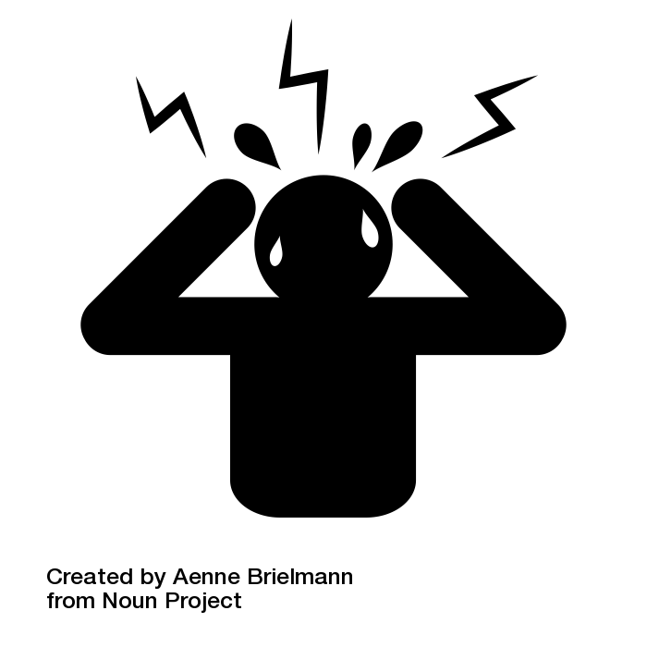
Kubernetes Security
Where to start?

Slide 13
Kubernetes Security

Slide 14
Kubernetes Security

Slide 15
Kubernetes Security

Slide 16
Kubernetes Security

Slide 17
Time for an example!

Slide 18
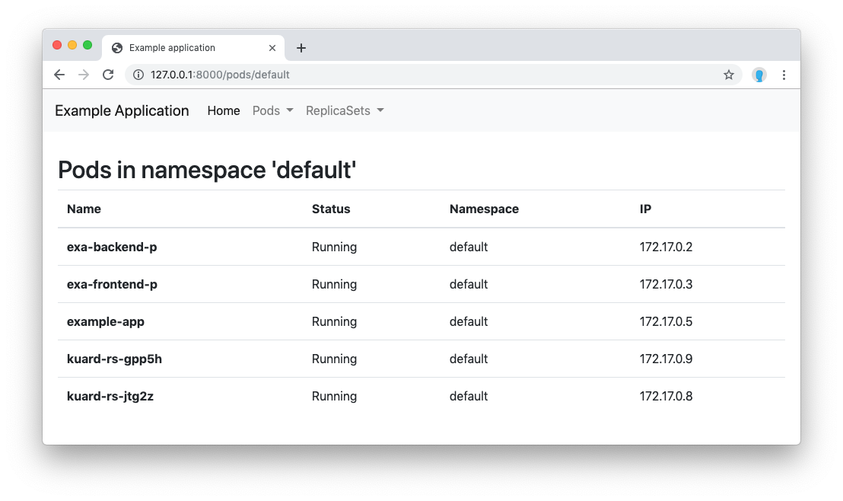

Slide 19
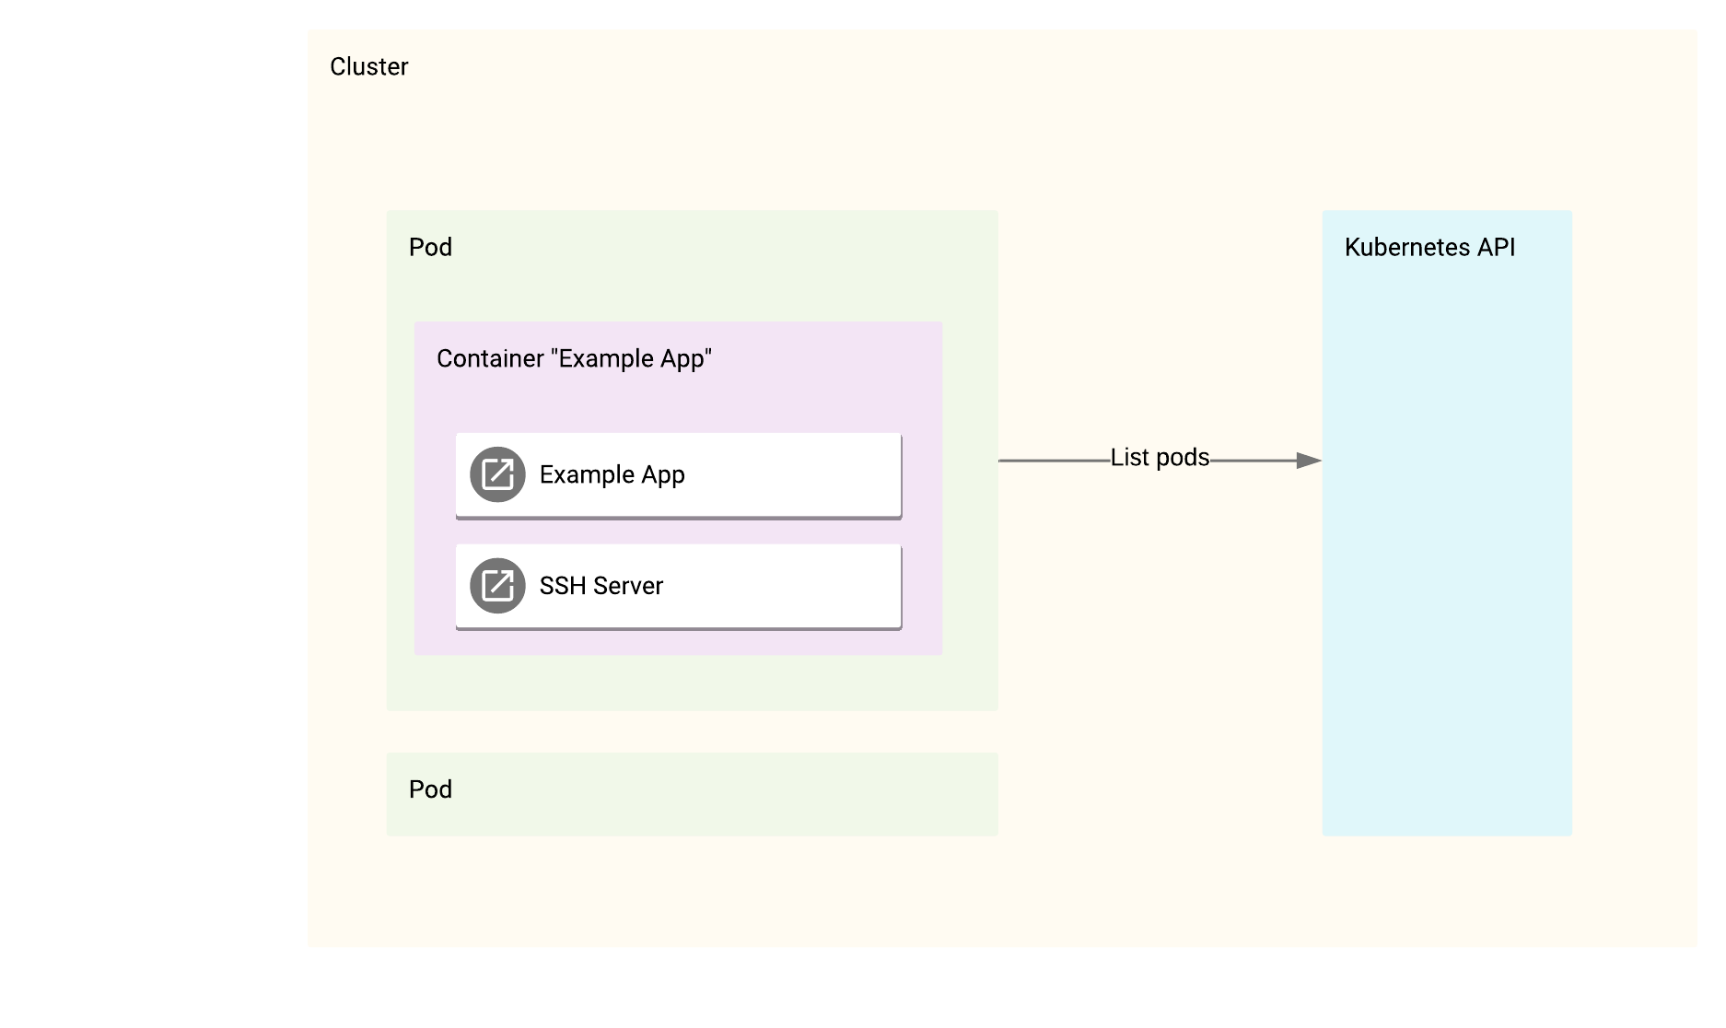

Slide 20
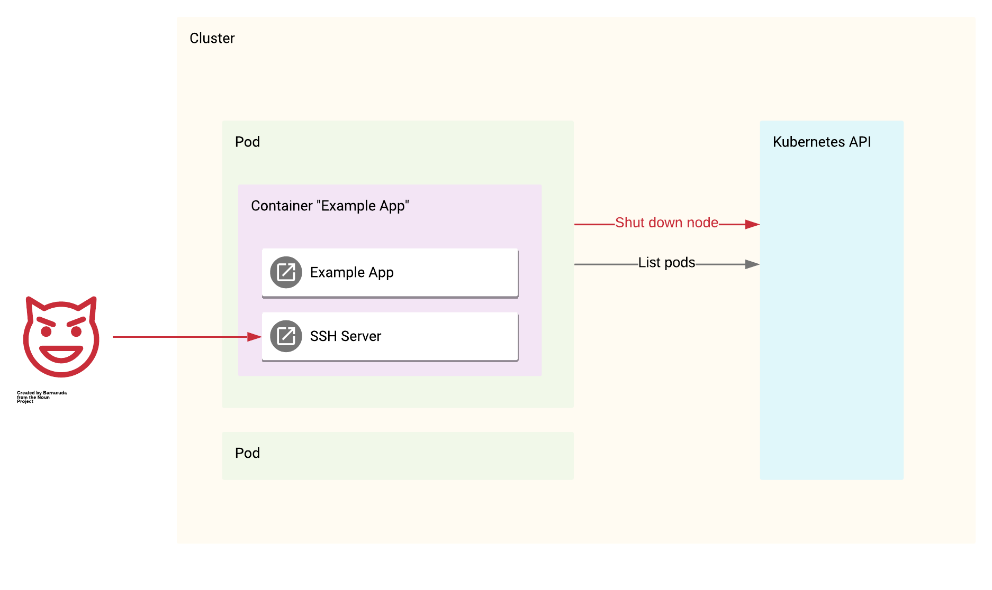

Slide 22


Slide 23
RBAC

Slide 24
CA?

Slide 26
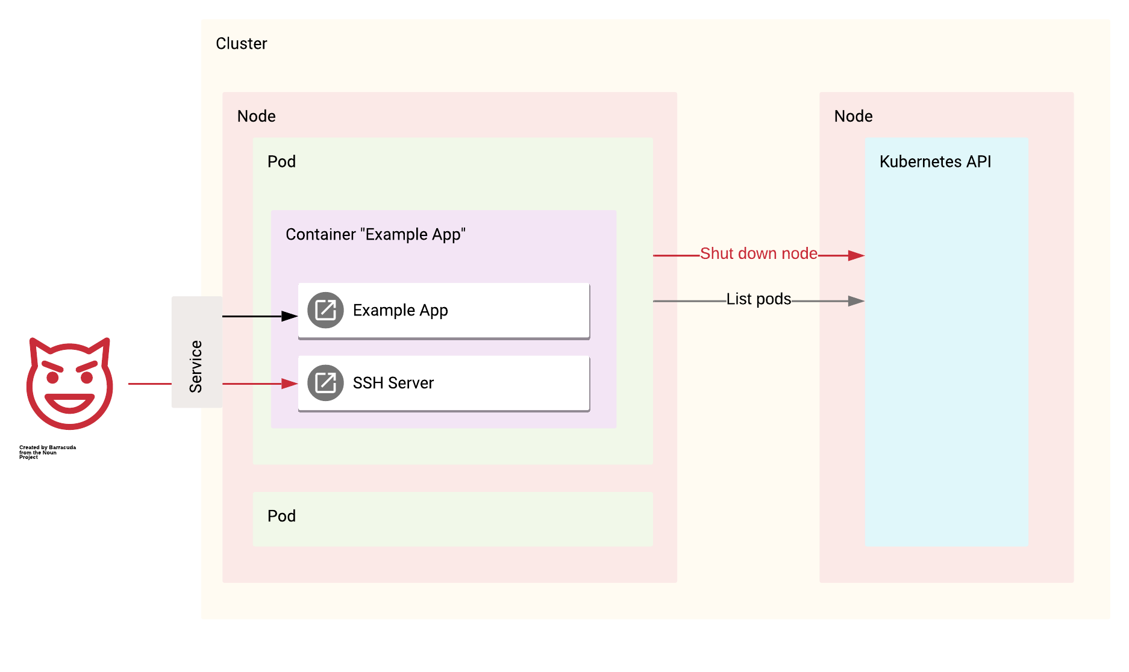

Slide 27
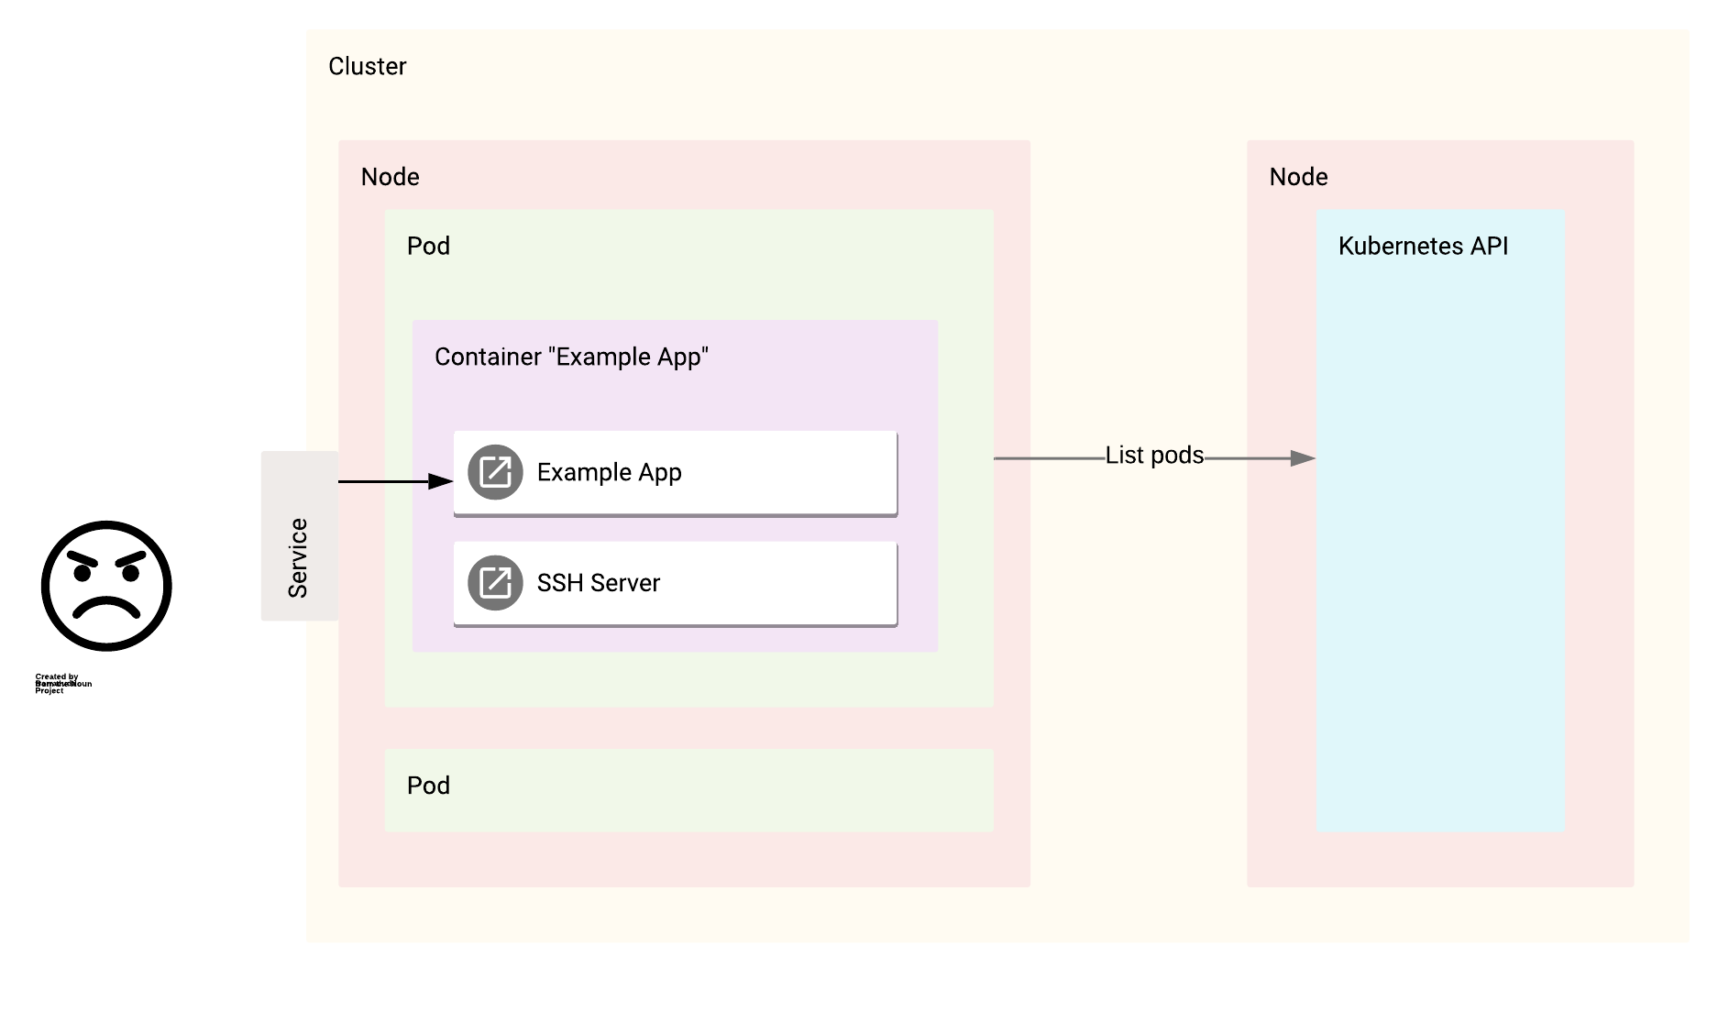

Slide 28
Security Aspects of Container Orchestration
Patrick Deutschmann, 28 June 2019

